Slide 1
Ex. 4.3
Using a refinement of predicate resolution prove:

Slide 2
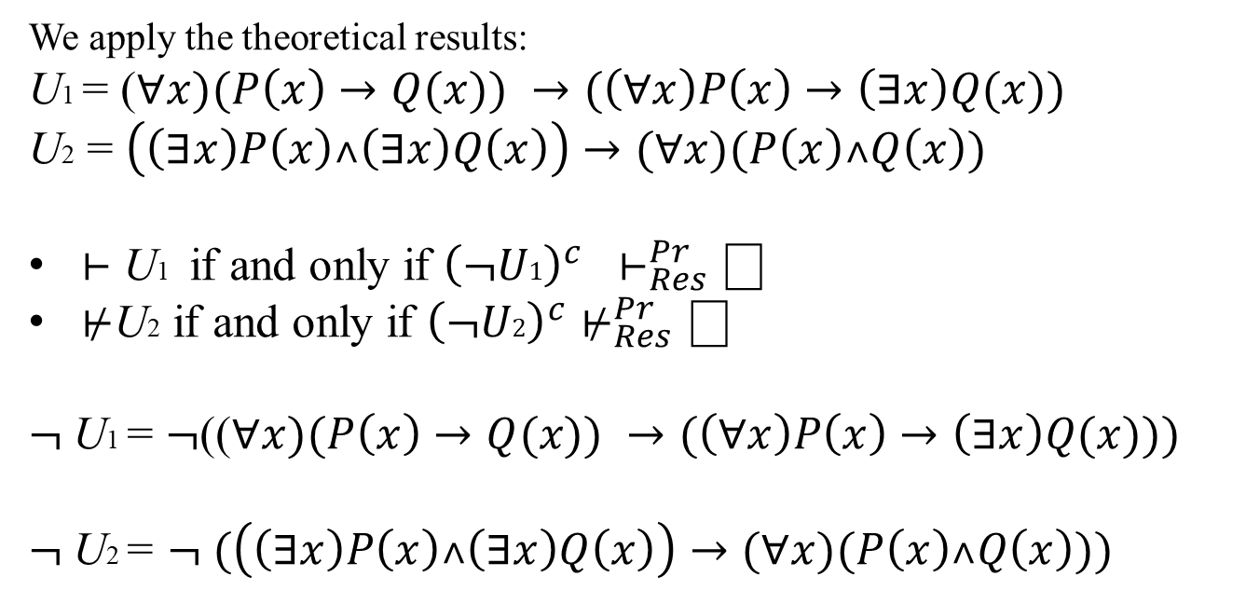
We apply the theoretical results:
U1 = ($∀x)(P\left(x\right)→Q(x)) →(\left(∀x\right)P\left(x\right)→\left(∃x\right)Q(x))$
U2 = $\left(\left(∃x\right)P\left(x\right)˄\left(∃x\right)Q\left(x\right)\right)→(∀x)(P\left(x\right)˄Q\left(x\right))$
$⊢$ U1 if and only if ${\left(¬U1\right)}^{c} ⊢_{Res}^{Pr}⎕$
$⊬$U2 if and only if ${\left(¬U2\right)}^{c}⊬_{Res}^{Pr}⎕$
$¬$U1 = $¬$(($∀x)(P\left(x\right)→Q(x)) →(\left(∀x\right)P\left(x\right)→\left(∃x\right)Q(x)))$
$¬$U2 = $¬ (\left(\left(∃x\right)P\left(x\right)˄\left(∃x\right)Q\left(x\right)\right)→(∀x)(P\left(x\right)˄Q\left(x\right)))$

Slide 3
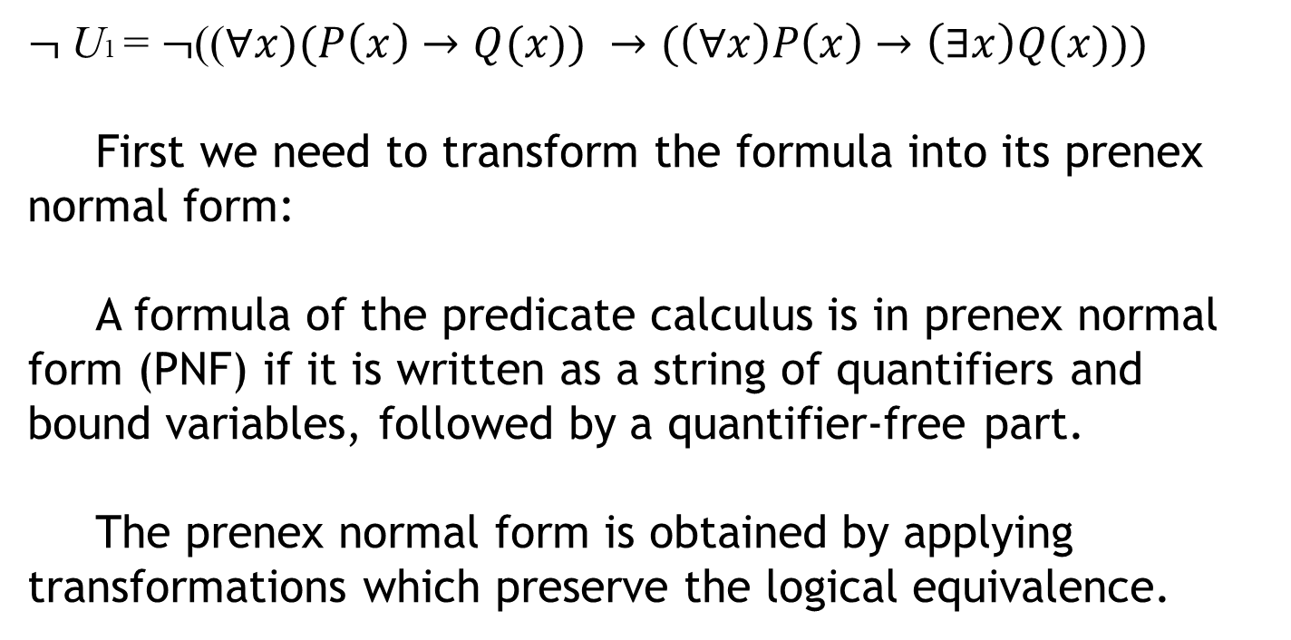
$¬$U1 = $¬$(($∀x)(P\left(x\right)→Q(x)) →(\left(∀x\right)P\left(x\right)→\left(∃x\right)Q(x)))$
First we need to transform the formula into its prenex normal form:
A formula of the predicate calculus is in prenex normal form (PNF) if it is written as a string of quantifiers and bound variables, followed by a quantifier-free part.
The prenex normal form is obtained by applying transformations which preserve the logical equivalence.

Slide 4
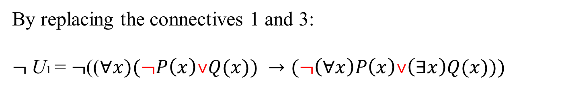
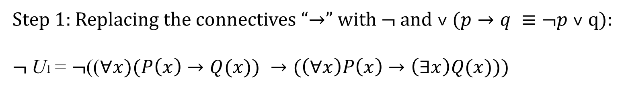
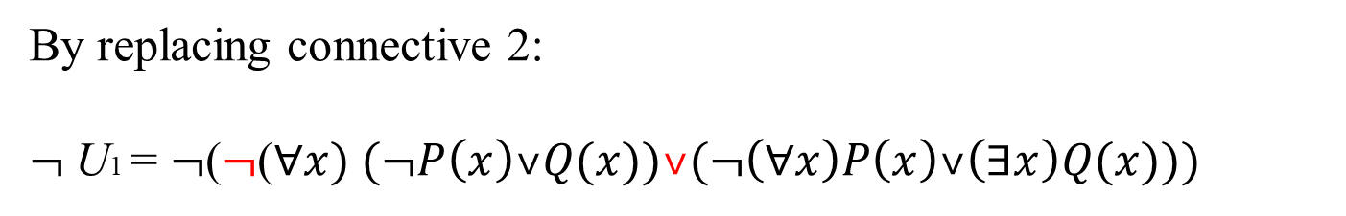
Step 1: Replacing the connectives “$→$” with $¬$ and ˅ $(p→q ≡¬p \text{˅} \text{q}\text{):}$
$¬$U1 = $¬$(($∀x)(P\left(x\right)→Q(x)) →(\left(∀x\right)P\left(x\right)→\left(∃x\right)Q(x)))$
1 2 3
By replacing the connectives 1 and 3:
$¬$U1 = $¬$(($∀x)(¬P\left(x\right)\text{˅}Q(x)) →(¬\left(∀x\right)P\left(x\right)\text{˅}\left(∃x\right)Q(x)))$
By replacing connective 2:
$¬$U1 = $¬$($¬$($∀x) (¬P\left(x\right)\text{˅}Q(x))\text{˅}(¬\left(∀x\right)P\left(x\right)\text{˅}\left(∃x\right)Q(x)))$

Slide 5
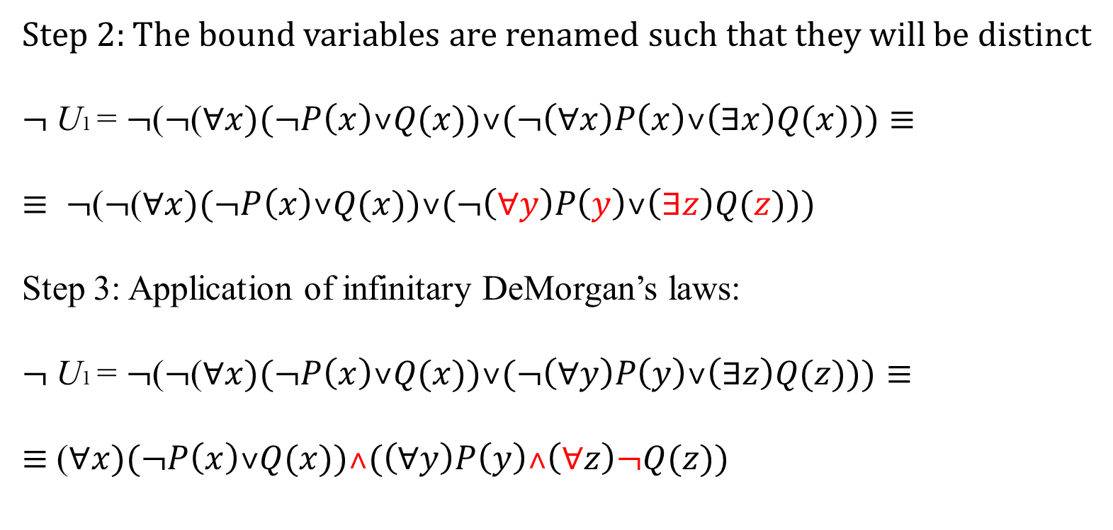
Step 2: The bound variables are renamed such that they will be distinct
$¬$U1 = $¬$($¬$($∀x)(¬P\left(x\right)\text{˅}Q(x))\text{˅}(¬\left(∀x\right)P\left(x\right)\text{˅}\left(∃x\right)Q(x)))≡$
$≡ ¬$($¬$($∀x)(¬P\left(x\right)\text{˅}Q(x))\text{˅}(¬\left(∀y\right)P\left(y\right)\text{˅}\left(∃z\right)Q(z)))$
Step 3: Application of infinitary DeMorgan’s laws:
$¬$U1 = $¬$($¬$($∀x)(¬P\left(x\right)\text{˅}Q(x))\text{˅}(¬\left(∀y\right)P\left(y\right)\text{˅}\left(∃z\right)Q(z)))$ $≡$
$≡$ ($∀x)(¬P\left(x\right)\text{˅}Q(x))\text{˄}(\left(∀y\right)P\left(y\right)\text{˄}\left(∀z\right)¬Q(z))$

Slide 6
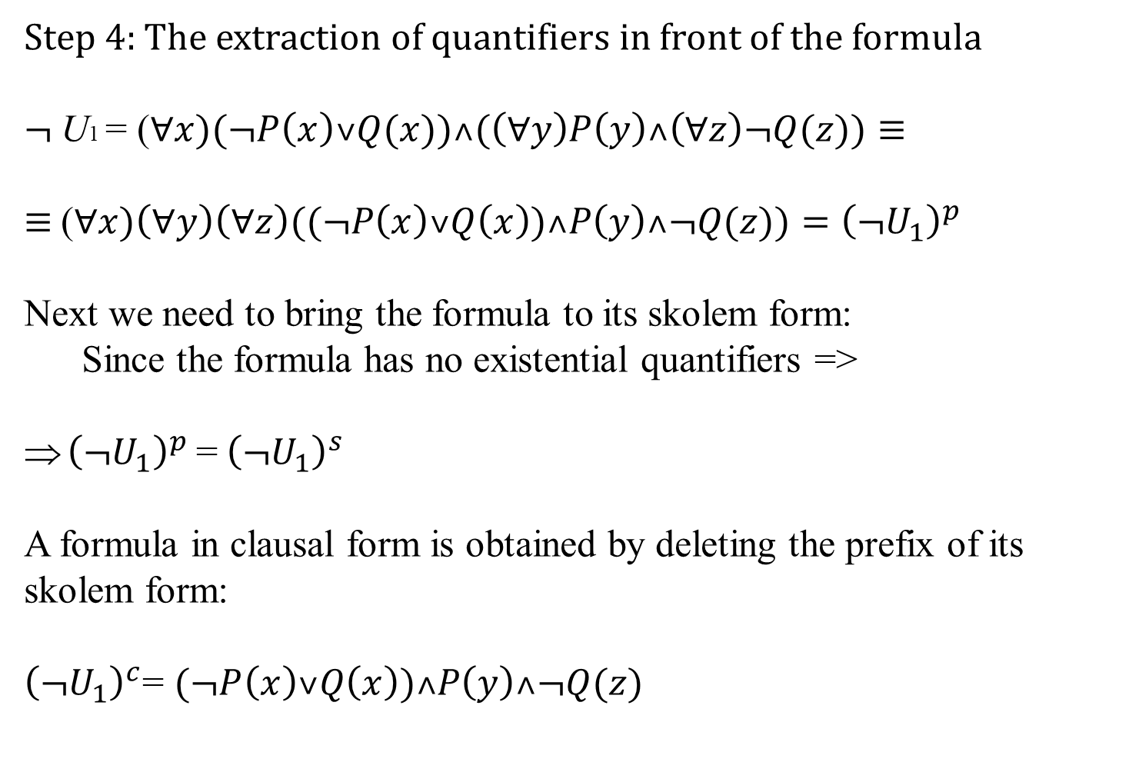
Step 4: The extraction of quantifiers in front of the formula
$¬$U1 = ($∀x)(¬P\left(x\right)\text{˅}Q(x))\text{˄}(\left(∀y\right)P\left(y\right)\text{˄}\left(∀z\right)¬Q(z))≡$
$≡$($∀x)\left(∀y\right)\left(∀z\right)((¬P\left(x\right)\text{˅}Q\left(x\right))\text{˄}P\left(y\right)\text{˄}¬Q(z))={\left(¬U_{1}\right)}^{p}$
Next we need to bring the formula to its skolem form:
Since the formula has no existential quantifiers =>
${\left(¬U_{1}\right)}^{p}$=${ \left(¬U_{1}\right)}^{s}$
A formula in clausal form is obtained by deleting the prefix of its skolem form:
${\left(¬U_{1}\right)}^{c}$= $(¬P\left(x\right)\text{˅}Q\left(x\right))\text{˄}P\left(y\right)\text{˄}¬Q(z)$

Slide 7


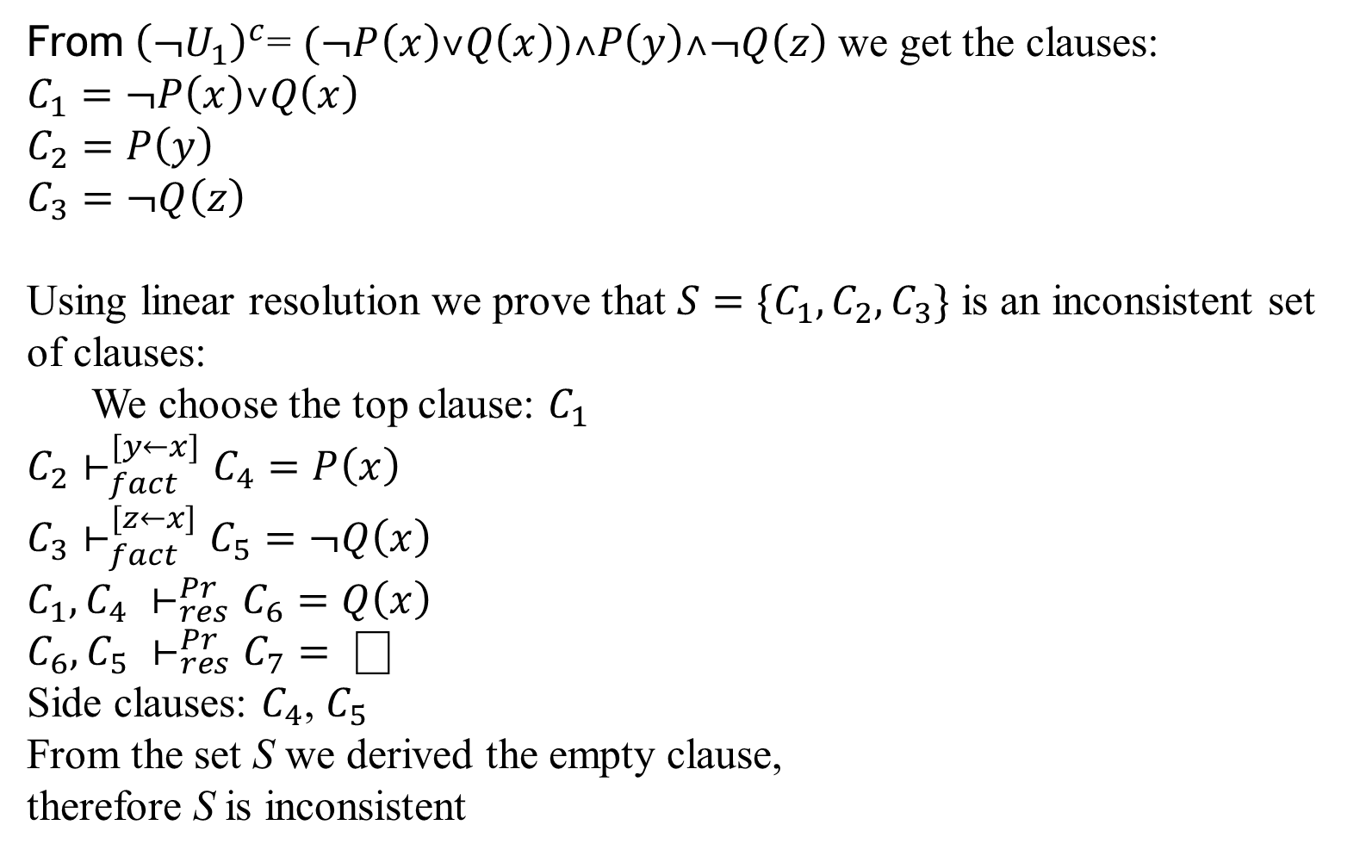



From${ \left(¬U_{1}\right)}^{c}$= $(¬P\left(x\right)\text{˅}Q\left(x\right))\text{˄}P\left(y\right)\text{˄}¬Q\left(z\right)$ we get the clauses:
$$C_{1}=¬P\left(x\right)\text{˅}Q\left(x\right)$$
$$C_{2}=P\left(y\right)$$
$$C_{3}=¬Q\left(z\right)$$
Using linear resolution we prove that $S=\{C_{1},C_{2},C_{3}\}$ is an inconsistent set of clauses:
We choose the top clause: $C_{1}$
$$C_{2}⊢_{fact}^{[y←x]}C_{4}=P\left(x\right)$$
$$C_{3}⊢_{fact}^{[z←x]}C_{5}=¬Q\left(x\right)$$
$$C_{1},C_{4} ⊢_{res}^{Pr}C_{6}=Q\left(x\right)$$
$$C_{6},C_{5} ⊢_{res}^{Pr}C_{7}= ⎕$$
Side clauses: $C_{4}$, $C_{5}$
From the set S we derived the empty clause,
therefore S is inconsistent
$$C_{1}$$
$$C_{4}$$
$$C_{6}$$
$$C_{5}$$
$$C_{7}$$

Slide 8
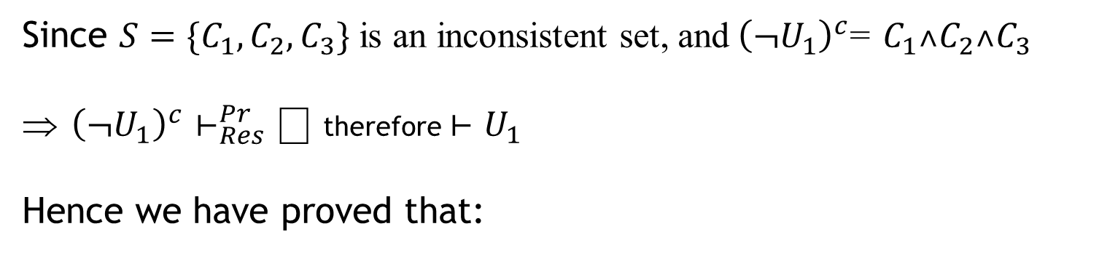
Since $S=\{C_{1},C_{2},C_{3}\}$ is an inconsistent set, and${ \left(¬U_{1}\right)}^{c}$= $C_{1}\text{˄}C_{2}\text{˄}C_{3}$
${ \left(¬U_{1}\right)}^{c}$ $⊢_{Res}^{Pr}⎕$ therefore $⊢U_{1}$
Hence we have proved that:

Slide 9
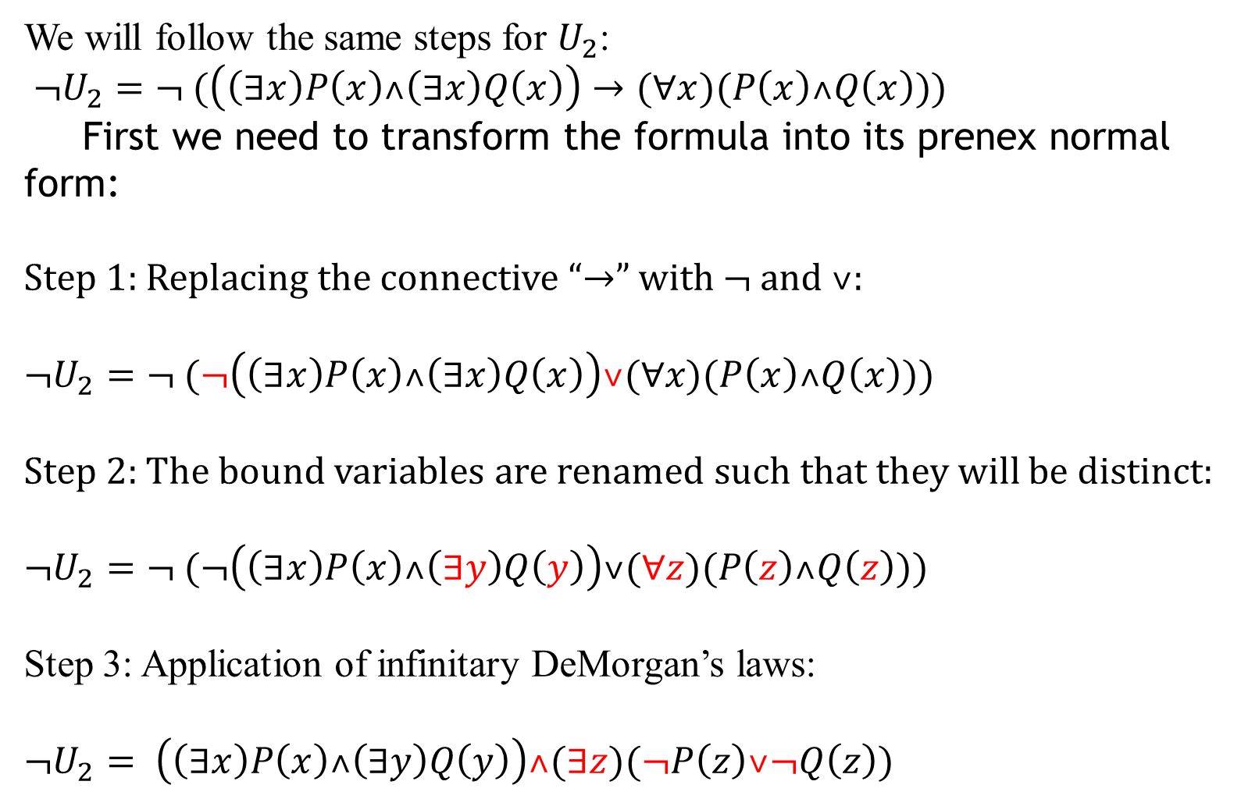
We will follow the same steps for $U_{2}$:
$¬U_{2}=¬ (\left(\left(∃x\right)P\left(x\right)˄\left(∃x\right)Q\left(x\right)\right)→(∀x)(P\left(x\right)˄Q\left(x\right)))$
First we need to transform the formula into its prenex normal form:
Step 1: Replacing the connective “$→$” with $¬$ and ˅:
$$¬U_{2}=¬ (¬\left(\left(∃x\right)P\left(x\right)˄\left(∃x\right)Q\left(x\right)\right)\text{˅}(∀x)(P\left(x\right)˄Q\left(x\right)))$$
Step 2: The bound variables are renamed such that they will be distinct:
$$¬U_{2}=¬ (¬\left(\left(∃x\right)P\left(x\right)˄\left(∃y\right)Q\left(y\right)\right)\text{˅}(∀z)(P\left(z\right)˄Q\left(z\right)))$$
Step 3: Application of infinitary DeMorgan’s laws:
$$¬U_{2}= \left(\left(∃x\right)P\left(x\right)˄\left(∃y\right)Q\left(y\right)\right)˄(∃z)(¬P\left(z\right)\text{˅}¬Q\left(z\right))$$

Slide 10

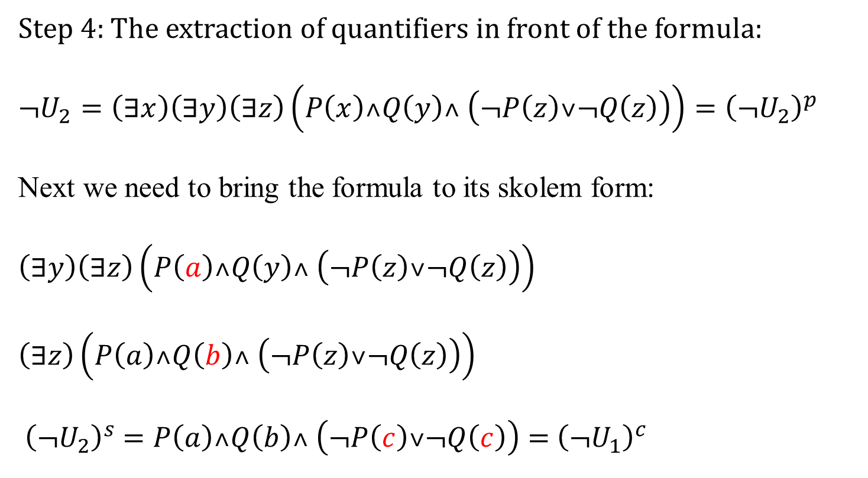


Step 4: The extraction of quantifiers in front of the formula:
$$¬U_{2}=\left(∃x\right)\left(∃y\right)\left(∃z\right)\left(P\left(x\right)˄Q\left(y\right)˄ \left(¬P\left(z\right)\text{˅}¬Q\left(z\right)\right)\right)={\left(¬U_{2}\right)}^{p}$$
Next we need to bring the formula to its skolem form:
$$\left(∃y\right)\left(∃z\right)\left(P\left(a\right)˄Q\left(y\right)˄ \left(¬P\left(z\right)\text{˅}¬Q\left(z\right)\right)\right)$$
$$\left(∃z\right)\left(P\left(a\right)˄Q\left(b\right)˄ \left(¬P\left(z\right)\text{˅}¬Q\left(z\right)\right)\right)$$
$${ \left(¬U_{2}\right)}^{s} =P\left(a\right)˄Q\left(b\right)˄ \left(¬P\left(c\right)\text{˅}¬Q\left(c\right)\right)={ \left(¬U_{1}\right)}^{c}$$
$$\left[x←a\right], a is a skolem constant$$
$$\left[y←b\right], b is a skolem constant$$
$$\left[z←c\right], c is a skolem constant$$

Slide 11
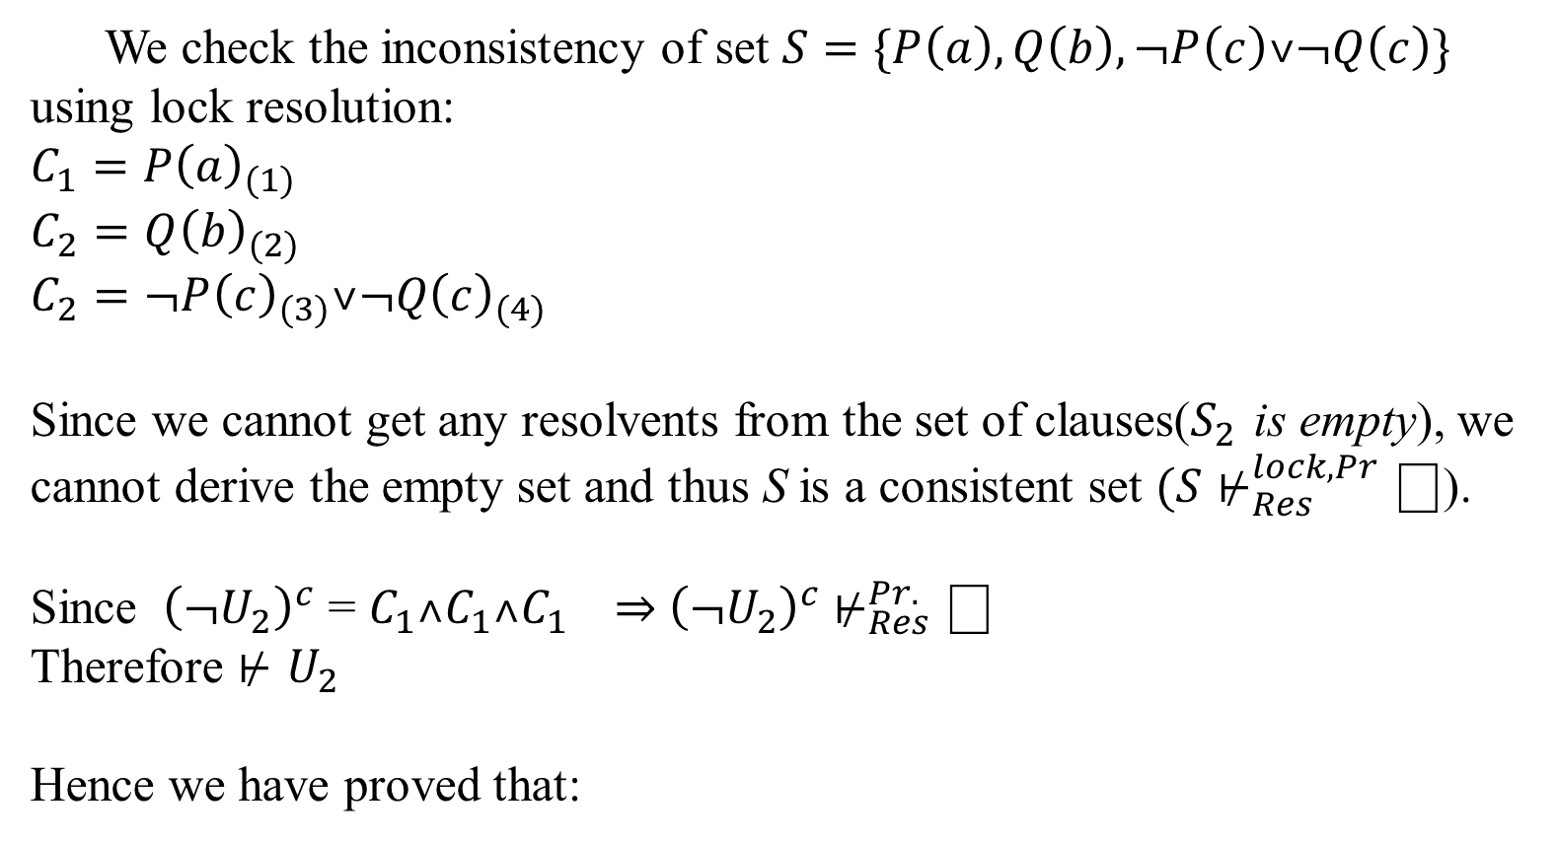
We check the inconsistency of set $S=\{P\left(a\right),Q\left(b\right),¬P\left(c\right)\text{˅}¬Q\left(c\right)\}$ using lock resolution:
$$C_{1}={P\left(a\right)}_{(1)}$$
$$C_{2}={Q\left(b\right)}_{(2)}$$
$$C_{2}={¬P\left(c\right)}_{(3)}\text{˅}{¬Q\left(c\right)}_{(4)}$$
Since we cannot get any resolvents from the set of clauses($S_{2}$ is empty), we cannot derive the empty set and thus S is a consistent set $(S⊬_{Res}^{lock, Pr}\text{⎕}\text{)}$.
Since ${ \left(¬U_{2}\right)}^{c}$ = $C_{1}˄C_{1}˄C_{1} ⇒{ \left(¬U_{2}\right)}^{c} ⊬_{Res}^{Pr.}\text{⎕}$
Therefore $⊬$ $U_{2}$
Hence we have proved that:

